Slide 1
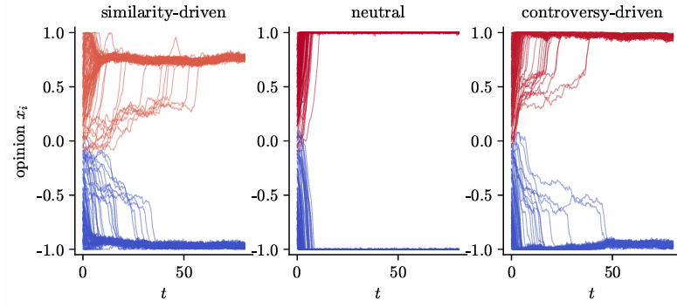
Cross-Cutting Exposure as an Engine of Radicalization
Platform design, attention, and geography in a stochastic multiplex model of opinion dynamics
Ruben E. Araújo · August 2026
with repulsive influence, uncurated exposure can polarize more than homophilic curation.

Slide 2
Why revisit cross-cutting exposure?
Echo chambers are a natural diagnosis - but the intervention record is mixed.
Social motivation
Echo-chamber hypothesis
“too little disagreement”
Intervention
more cross-cutting exposure
• The standard story: algorithms hide disagreement, creating echo chambers and polarization.
• The intuitive remedy: expose people to the other side.
• But field experiments show heterogeneous effects: cross-cutting exposure can reduce, leave unchanged, or increase polarization.
Open problem
when does exposure heal vs. polarize?
Physics motivation
• Local interactions generate fragmented bounded-confidence clusters.
• Digital platforms create adaptive long-range exposure, but attention is finite.
• The key question is kinetic: which exposure profiles activate repulsion, and how fast?
This work asks for a mechanism, not just a direction of effect.
MOTIVATION
Cross-cutting exposure as an engine of radicalization

Slide 3
Main contribution: a kinetic theory of platform exposure
The novelty is not that exposure can backfire, but that platform design can be mapped to a radicalization timescale.
1
Conserved attention
platform design
E(Δ)
Digital exposure displaces physical interaction instead of adding a new force on top.
exposure profile
p(y)
2
Repulsive-zone exposure
A platform kernel E(Δ) determines how often agents see content far enough away to trigger repulsion.
radicalization time
t(y0 → yf)
3
Timescale, not threshold
After bounded-confidence fragmentation forms, any nonzero cross-bloc exposure creates outward drift in the two-bloc reduction.
Core thesis
Exposure diversity is not intrinsically good or bad; its effect depends on where the exposure lands relative to the influence function.
CONTRIBUTION
Cross-cutting exposure as an engine of radicalization

Slide 4
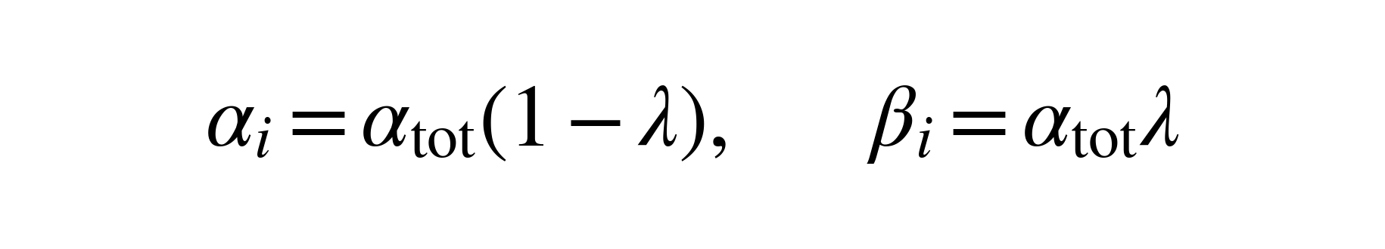

Model: physical space + adaptive digital attention
Agents carry positions and opinions; a platform rewires a fixed number of attention slots.
Physical layer
Brownian mobility
short-range bounded confidence
Digital layer
adaptive directed graph Aij
k fixed attention slots
Opinion dynamics
assimilation / indifference / repulsion
Finite attention is the bridge: increasing digital exposure reduces physical influence.
• N = 200 reference agents; system-size scans to N = 1600
• projected opinions x ∈ [−1, 1]; periodic physical space
• heavy-tailed strengths tested, but not required for the inversion
MODEL
Cross-cutting exposure as an engine of radicalization

Slide 5
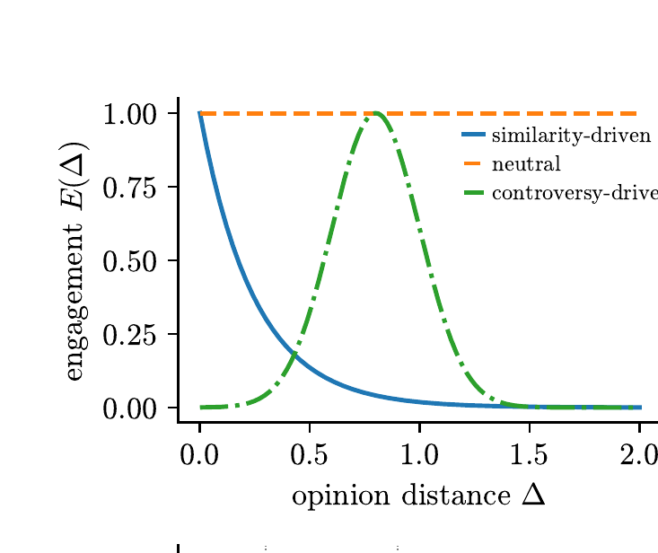
The decisive ingredient is not exposure alone
Exposure only matters when it lands inside the repulsive branch of the influence function.
Three platform designs
• Similarity-driven: hides distant views; creates echo-chamber feeds.
• Neutral: samples opinion-blind; cross-bloc content remains visible.
• Controversy-driven: promotes content near a preferred ideological distance.
Three influence zones
• Assimilate when opinions are close.
• Ignore intermediate disagreements.
• Repel when the opinion gap exceeds the rejection threshold ε2.
Intuition: a platform can be polarizing not because it creates echo chambers, but because it keeps enough content in the repulsive zone.
MODEL
Cross-cutting exposure as an engine of radicalization

Slide 6



Two-bloc reduction: exposure becomes a rate
Once bounded-confidence dynamics has formed two blocs, the physical layer no longer pulls them together.
Late-stage ansatz
Two symmetric blocs at opinions +y and −y.
p(y): stationary fraction of attention slots pointing across blocs.
Repulsion turns cross-bloc exposure into outward drift.
General result: any curation kernel maps to an exposure profile p(y), and the quadrature gives the radicalization timescale.
No positive threshold within the deterministic reduction: if p(y) > 0 along the path, the blocs drift outward; what changes is the timescale.
THEORY
Cross-cutting exposure as an engine of radicalization

Slide 7
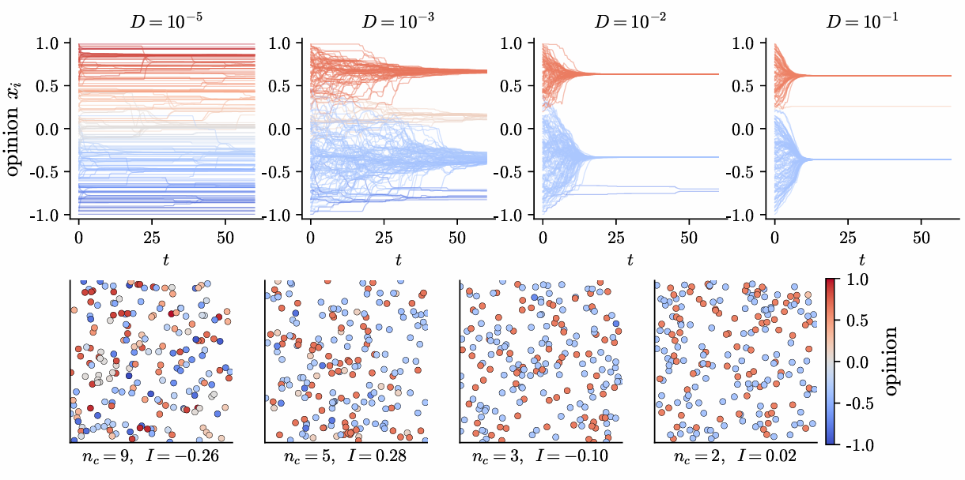
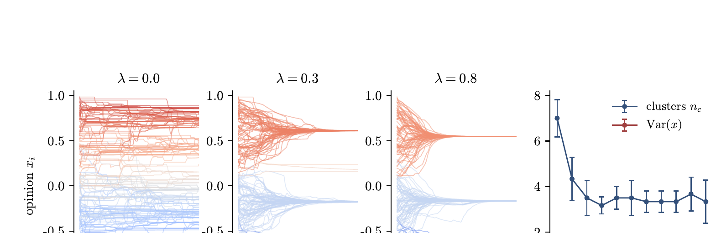
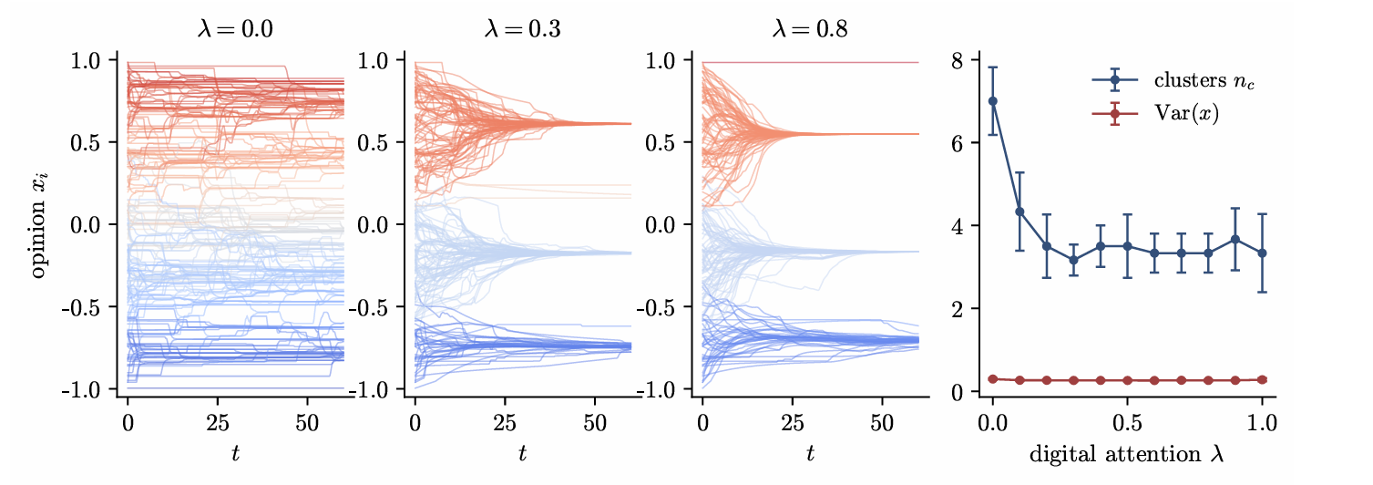
Assimilative baseline: mobility and neutral links heal fragmentation
Before repulsion is activated, long-range opinion-blind exposure behaves like effective mobility.
Physical-only bounded confidence
Static neutral digital layer
• Low D freezes several local clusters.
• High D approaches the mean-field bounded-confidence outcome.
• No stable geographic color domains appear under opinion-independent mobility.
• Modest digital attention merges fragmented local clusters.
• This is the benign effect expected from exposure diversity in a purely assimilative world.
• The later inversion depends on activating the repulsive branch.
BASELINES
Cross-cutting exposure as an engine of radicalization

Slide 8
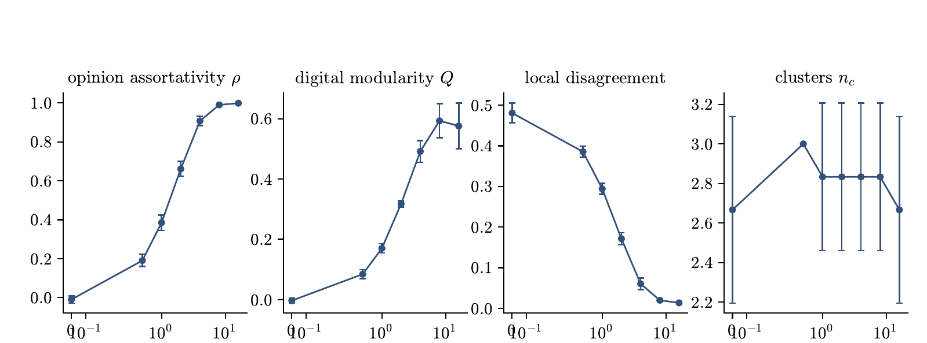
Algorithmic homophily builds echo chambers - without geographic localization
In the assimilative model, similarity recommendation hides disagreement and preserves moderate fragmentation.
What changes as homophily γ increases?
• Opinion assortativity approaches one.
• Digital modularity rises.
• Visible local disagreement collapses.
• Cluster count remains moderate: fragmentation is hidden, not radicalized.
This creates a delocalized echo chamber: high global separation, low feed-level disagreement, but no spatial opinion map.
BASELINES
Cross-cutting exposure as an engine of radicalization

Slide 9
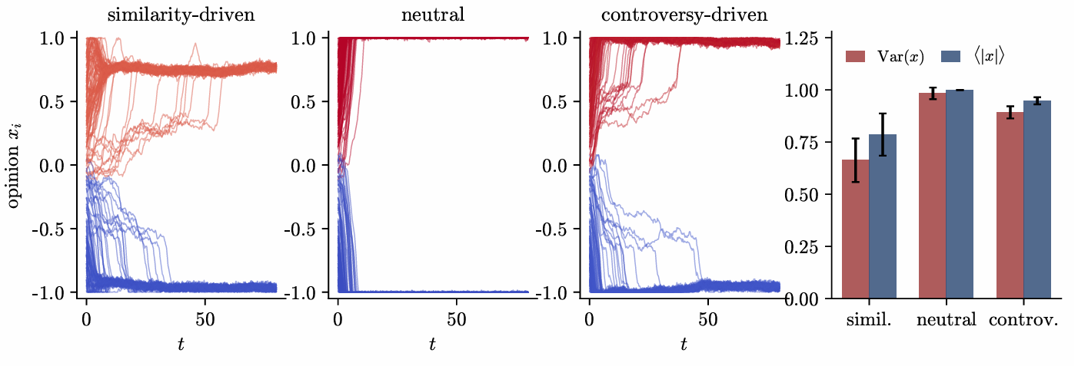
The inversion: uncurated exposure radicalizes most
With repulsive influence, the ranking of platform designs reverses.
1
Neutral platform
2
Controversy platform
3
Similarity platform
Fastest and most polarizing: half of every feed remains cross-bloc content.
Nearly as extreme, but arrests just short of the boundary as engagement collapses near maximum separation.
Least polarizing on finite horizons because homophily starves the repulsive channel.
Key distinction: the neutral platform polarizes with near-zero opinion assortativity - polarization without echo chambers.
MAIN RESULT
Cross-cutting exposure as an engine of radicalization

Slide 10
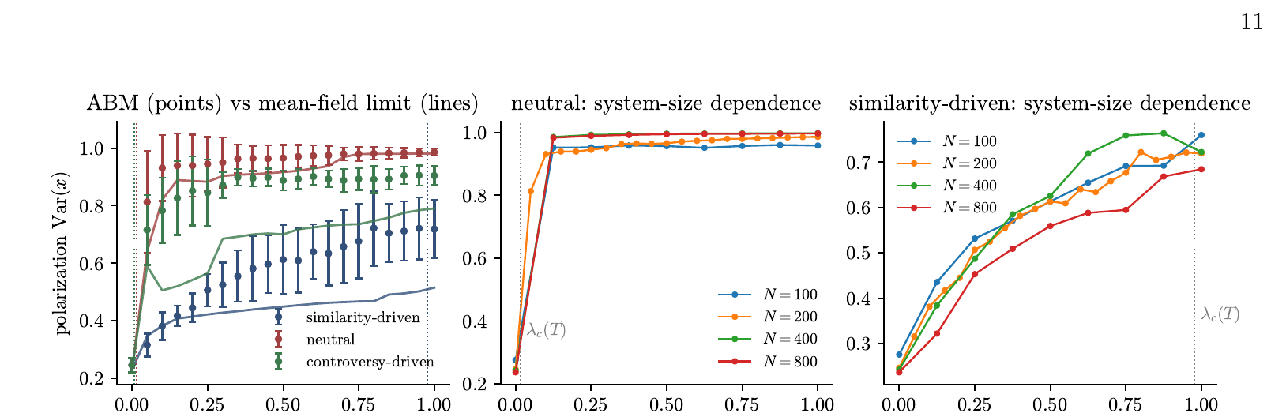

Onset is finite-horizon kinetics, not a phase transition
The apparent critical attention share is the time needed to traverse from y0 to yf.
Table I · two-bloc rate analysis
Platform | p0 | t_rad(λ) | λc(T=80)
Similarity-driven | 0.0082 | 78.2/λ | 0.98
Neutral | 0.500 | 1.28/λ | 0.016
Controversy-driven | 0.998 | 0.64/λ | 0.008
• Neutral and controversy crossovers lie below the grid resolution: λc ≈ 0.01-0.02.
• Similarity has λc ≈ 1: finite-horizon “protection” is a slow-rate effect, not asymptotic safety.
• The well-mixed limit matches neutral nearly quantitatively and tracks the other curves.
THEORY ↔ SIMULATION
Cross-cutting exposure as an engine of radicalization

Slide 11
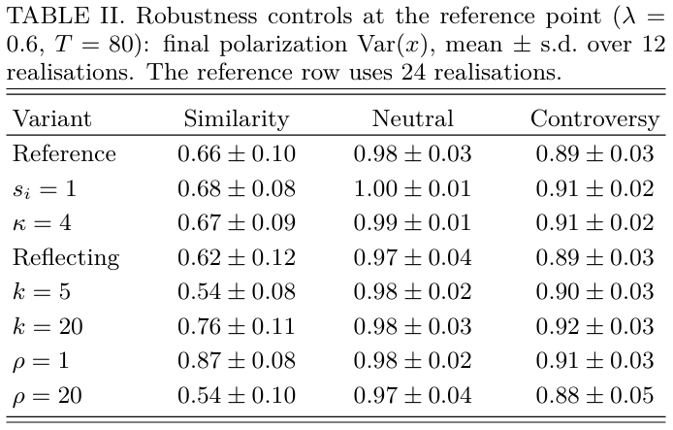
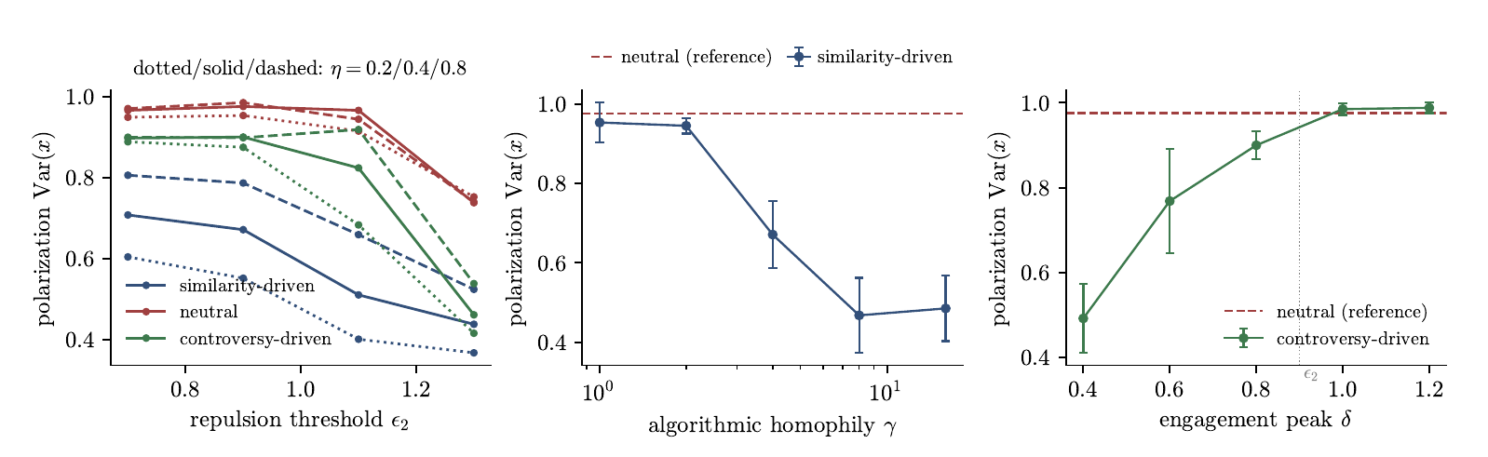
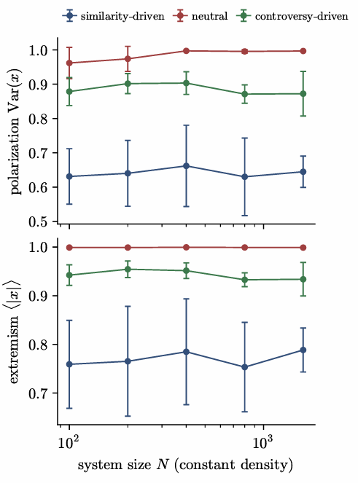
Robustness: the ordering survives structural controls
The inversion is not a heavy-tail artifact, boundary artifact, or small-system artifact.
• Homogeneous strengths and finite-variance strengths reproduce the same platform ordering.
• Reflecting boundaries preserve the effect, so saturation is not created by clipping.
• Fast rewiring strengthens homophilic protection; slow rewiring lets rare cross-bloc links act longer.
• System-size scans up to N = 1600 are essentially flat at constant density.
ROBUSTNESS
Cross-cutting exposure as an engine of radicalization

Slide 12
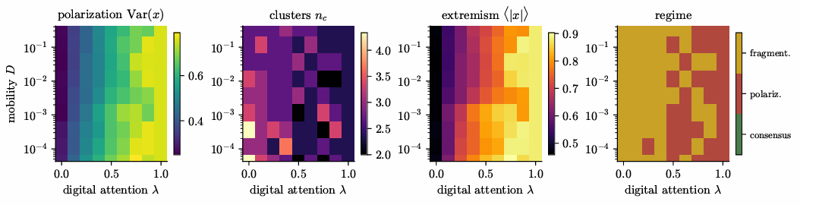
Attention can neutralize geography
When the platform owns most exposure, physical mobility no longer controls the outcome.
Interpretation of the regime map
• At λ ≈ 0, the physical layer determines the outcome through the mobility D.
• As λ grows, digital attention activates residual cross-cutting repulsion.
• At high λ, polarization and extremism become nearly independent of D.
Figure 10 is intentionally a coarse regime map: boundaries are qualitative at 3 realizations per point.
Physical intuition: geography only matters for populations whose attention it still owns.
GEOGRAPHY
Cross-cutting exposure as an engine of radicalization

Slide 13
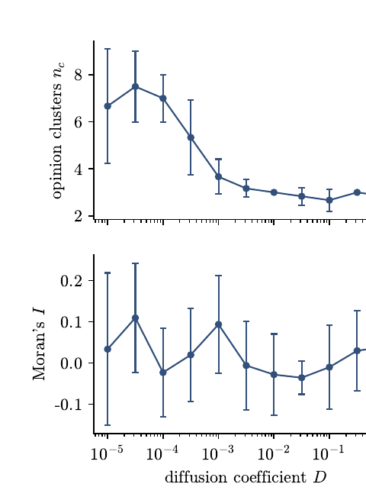
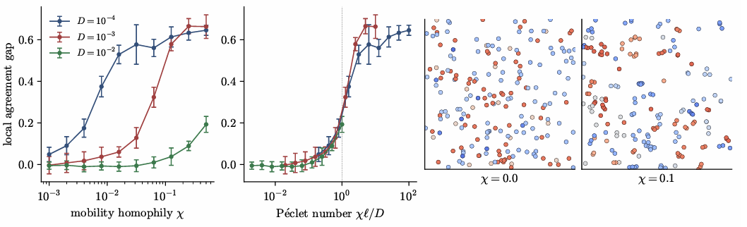

Brownian mobility alone does not create geographic opinion domains
Spatial opinion structure appears only when movement itself is coupled to opinion.
• With opinion-independent Brownian motion, Moran’s I and pair-level agreement remain at noise level.
• Adding homophilic drift creates domains once drift beats diffusion over the interaction range.
• The collapse occurs in the Péclet number Pe = χℓ/D, with onset around Pe ~ 1.
GEOGRAPHY
Cross-cutting exposure as an engine of radicalization

Slide 14
What the model says socially - and what it does not say
The result is a conditional mechanism, not a calibrated claim about real platforms.
1
Exposure diversity has a sign problem
intervention
more opposing content
psychology
assimilation vs. repulsion
If influence is assimilative, cross-cutting exposure heals fragmentation. If strongly opposed views repel, the same intervention can radicalize.
2
Echo chambers are not the only route to polarization
The neutral platform reaches maximal polarization while retaining near-zero opinion assortativity.
outcome
heal or radicalize
3
Platform design is a kinetic filter
Curation decides how much exposure lies in the repulsive zone and therefore sets the radicalization timescale.
Empirical caveat
The repulsive branch is contested and the model is not calibrated to data. The claim is: if negative influence is prevalent, exposure interventions must condition on it.
INTERPRETATION
Cross-cutting exposure as an engine of radicalization

Slide 15
Limitations and future work
The model isolates a mechanism; several extensions are natural.
Current limitations
Next steps
• One-dimensional opinions and fixed confidence bounds.
• Fixed attention share λ instead of platform-optimized attention allocation.
• Engagement kernel is a function of opinion distance, not learned behavior.
• Repulsive influence is treated as a conditional mechanism, not an empirically settled assumption.
• Stubborn agents are implemented but not systematically swept.
• Derive a rigorous McKean-Vlasov limit for finite-variance strengths and a non-self-averaging theory for heavy tails.
• Endogenize λ with an engagement-maximizing platform.
• Sweep stubborn-agent number and placement against platform design.
• Use field experiments to estimate repulsive-zone prevalence and test exposure-diversity sign changes.
Research question for future empirical work: for whom, and at what opinion distances, does exposure create assimilation versus repulsion?
LIMITS & NEXT STEPS
Cross-cutting exposure as an engine of radicalization

Slide 16
Takeaways
The central result is kinetic: platform design determines the rate at which repulsion is activated.
1
Inversion
With repulsive influence, neutral exposure can polarize more than homophilic curation.
2
Mechanism
A platform kernel E(Δ) maps to p(y); the quadrature of 1/[y p(y)] sets the radicalization time.
3
Geography
Brownian mobility alone does not generate spatial opinion domains; opinion-dependent movement crosses a Péclet threshold.
Final implication
Exposure diversity should be treated as a mechanism-dependent intervention, not a universal remedy.
CONCLUSION
Cross-cutting exposure as an engine of radicalization

